Slide 1
The Project Approach
Data Gathering
Request sent via Postman to Yelp
Response captured in JSON format.
Data Processing
Reviewed the JSON file and finalized the Business Categories
Data Visualizations
Converted the CSV files to Data Frame using Pandas
Generated the necessary Bar Charts using Matplotlib
Process JSON file using Python and generated a CSV file for each business Category
The objective was to gather the data related to the number of Businesses categories (see the list below) present in St Louis City. The analysis would provide a snap shot to an individual when he/she is checking out a particular area with the intend to live or visit.
Food (Fast Food Joints, Restaurants)
Stores(Department, Grocery, Gas)
Financial Institutions (Banks, Loans etc.)
Hospitals, Urgent Care Centers
Universities/Colleges, Daycare Centers
Hotels, Bed & Breakfast
Data Analysis Tools Used
Postman
Yelp
JSON
Python
Matplotlib
Pandas
Excel

Slide 2
The Project Approach
Data Gathering
Request sent via Postman to Yelp
Response captured in JSON format.
Data Processing
Reviewed the JSON file and finalized the Business Categories
Data Visualizations
Converted the CSV files to Data Frame using Pandas
Generated the necessary Bar and Stacked Bar Charts of Business by zip using Matplotlib.
Process JSON file using Python and generated a CSV file for each business Category
Provided a tab to query the Business by Zip using Java Script.
Data Analysis Tools Used
Postman
Yelp
JSON
Python
Matplotlib
Pandas
Java Script
Excel

Slide 3
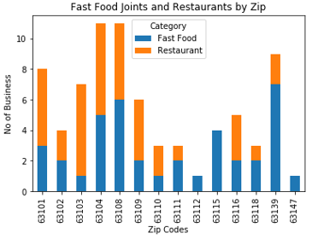
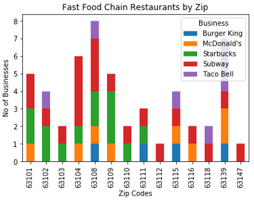
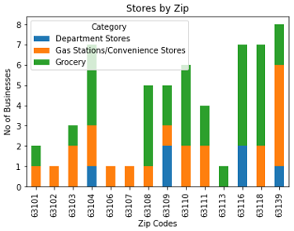
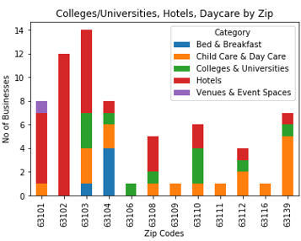
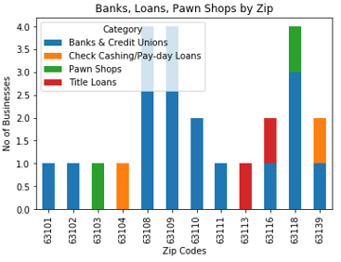
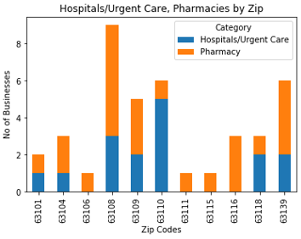
Business - Data Visualizations

Slide 4
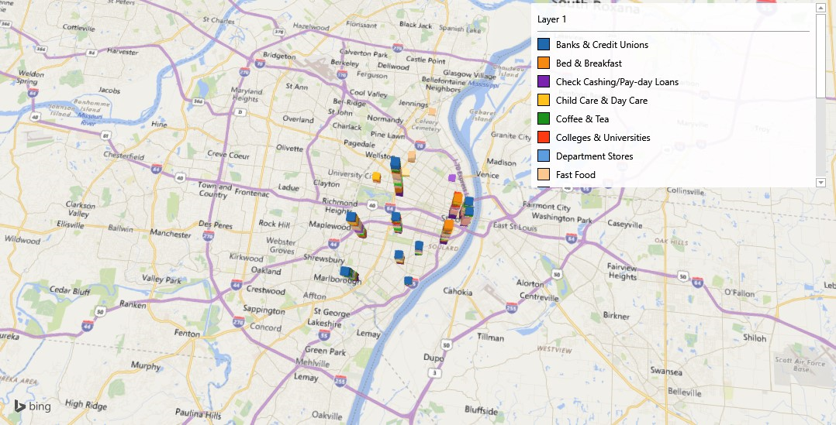
Challenges, Take a ways
Challenges:
When sending a Business request via postman. Yelp had limitations to providing only 50 responses (max limit) Had to send multiple requests to obtain the required data.
In some cases I had to customize the python code to accommodate the categories within the JSON file as they were not uniform.
Same businesses spelt in JSON response with different formats. Had to customize the code to accommodate it.
Takeaways
Learnt a how to apply the Data Analytics skills obtained so far in this project.
Plan to have a strategy when trying to pull the data. I plan to look into Google’s Geo locator for conducting Business search.
I plan to do the following to improve the current solution by doing the following
Expanding the Data Visualizations by using maps.
Providing a rating module which will assist in providing a rating for each zip code.

